Slide 1
A Terabit Secure Network Data-Plane
Software for Breaking the Barriers: 1 Tb/s, 1 Bpkts/s, …
FastData.io Project

Slide 2










A Terabit Secure Network Data-Plane For Cloud Network Services
EFFICIENCY
Most Efficient on the Planet
The most efficient software data plane Packet
Processing on the planet
PERFORMANCE
Superior Performance
FD.io on x86 servers outperforms specialized packet processing HW
Flexible and Extensible
SOFTWARE NETWORKING
Software programmable, extendable and flexible
Cloud Networking
CLOUD NETWORK SERVICES
Foundation for cloud network services
Open Source
LINUX FOUNDATION
Open source collaborative project in Linux Foundation
Breaking the Terabit Barrier of Secure NaaS Services on a Single 2-Socket Intel® Xeon® Server !
2

Slide 3



FD.io VPP – Vector Packet Processor Compute Optimized SW Network Platform
Bare-metal / VM / Container
Packet Processing Software Platform
High performance
Linux user space
Runs on compute CPUs:
And “knows” how to run them well !
Shipping at volume in server & embedded products since 2004
Management Agent
Packet Processing
Network IO

Slide 4
FD.io VPP – The “Magic” of Vectors
Compute Optimized SW Network Platform
1
Packet processing is decomposed
into a directed graph of nodes …
2
… packets move through graph nodes in vector …
3
… graph nodes are optimized to fit inside the instruction cache …
vhost-user-
input
af-packet-
input
dpdk-input
Packet 0
Packet 1
Microprocessor
ethernet-
input
Packet 2
Instruction Cache
Packet 3
3
cdp-input
l2-input
ip4-input
ip6-input
Packet 4
arp-input
lldp-input
...-no-
checksum
Packet 5
Data Cache
mpls-input
4
Packet 6
ip4-lookup-
mulitcast
ip4-lookup*
Packet 7
Packet 8
mpls-policy-
encap
ip4-load-
balance
ip4-rewrite-
transit
ip4-
midchain
Packet 9
… packets are pre-fetched into the data cache.
4
Packet 10
interface-
output
* Each graph node implements a “micro-NF”, a “micro-NetworkFunction” processing packets.
Makes use of modern Intel® Xeon® Processor micro-architectures. Instruction cache & data cache always hot ➔ Minimized memory latency and usage.

Slide 5

FD.io Benefits from Intel® Xeon® Processor Developments Increased I/O and Cipher Processing Improve Crypto Throughput
FD.io
Terabit Encryption and Decryption
Crypto operations in socket processor.
= Terabit NaaS
Intel® Xeon®
YESTERDAY
TODAY
IPsec Forwarding Rate [Gbps]
1 000* Gbps
Server
[2 Sockets]
+117%
460
Terabit Encryption and Decryption in Software in Socket Processors
Network I/O PCIe Gen3: 320 Gbps
Per Core Caches: L1d 32 KB, L2 1.0 MB
Memory: 6-channels 2666 MHz
Max power: 150 W (TDP)
Server
[1 Socket]
+117%
500
Network I/O PCIe Gen4: 600 Gbps
Per Core Caches: L1d 48 KB, L2 1.25 MB
Memory: 8-channels 3200 MHz
Max power: 250 W (TDP)
1
FD.io Takes Full Advantage of Faster Intel® Xeon® Scalable Processors
Minimal Code Change Rrequired
1
2
230
2
3
3
4
4
Intel® Xeon® 6252N 24 Cores, 2.3 GHz, 33 MB Cache
0 200 400 600 800 1000 1200
Intel® Xeon® 8360Y D Stepping
36 Cores, 2.4 GHz, 54 MB Cache
Intel® Xeon® 6252N
Intel® Xeon® 8360Y D Stepping Processors
* IPsec forwarding rate bound by multiple instruction execution factors. Measured for 1024B cleartext frame size.
Breaking the Terabit Barrier of Secure NaaS Services on a Single 2-Socket Intel® Xeon® Server !

Slide 6
FD.io Benefits from Intel® Xeon® Processor Developments Increased I/O and Processing Power Improve Packet Throughput
FD.io
Terabit Encryption and Decryption
Crypto operations in socket processor.
= Terabit NaaS
Intel® Xeon®
YESTERDAY
TODAY
IPv4 Forwarding Rate [Gbps]
1 200* Gbps
Server
[2 Sockets]
+88%
640
Terabit Packet Processing in Software in Socket Processors
Network I/O PCIe Gen3: 320 Gbps
Per Core Caches: L1d 32 KB, L2 1.0 MB
Memory: 6-channels 2666 MHz
Max power: 150 W (TDP)
Server
[1 Socket]
+88%
600
Network I/O PCIe Gen4: 600 Gbps
Per Core Caches: L1d 48 KB, L2 1.25 MB
Memory: 8-channels 3200 MHz
Max power: 185 W (TDP)
1
1
2
320
2
3
3
4
4
Intel® Xeon® 6252N 24 Cores, 2.3 GHz, 33 MB Cache
0 200 400 600 800 1000 1200
Intel® Xeon® 6338N
32 Cores, 2.2 GHz, 42 MB Cache
Intel® Xeon® 6252N
Intel® Xeon® 6338N Processors
* IPv4 forwarding rate bound by PCIe I/O. Measured for 1024B frame size.
Breaking the Terabit Barrier of Secure NaaS Services on a Single 2-Socket Intel® Xeon® Server !

Slide 7





FD.io VPP & Cloud Network Services
Use Case Examples
SECURE NaaS CLOUD NETWORKING
Encrypted Overlays for Secure Access, Edge and Connectivity
IPsec, TLS, QUIC, WireGuard - Fast Modern VPNs
Horizontal Scaling with Near Linear Multi-core Speed-up
Secure Tunnels: 40 Gbps / Core, up to 1 Tbps / 2 Sockets
Scale of Million Routes with Service Features
Performance at Max. of PCIe I/O of Intel® Xeon® Server
PRODUCTION
GRADE
SECURE NaaS CLOUD
NETWORKING
MULTI-TENANT SERVICES
Per Tenant Stateless and Stateful Packet Processing
Rich IPv4/IPv6 Functionalities, API First Consumption Model
Zero Cost Telemetry with Always-on Pervasive Data-plane Counters
Service Features: ACLs, NAT, Sessions, VRFs
Multi-Tenant Scale and Elasticity
Scale of Million Flows with Service Features
MULTI-TENANT
SERVICES
Substantial Performance and Efficiency Gains vs. Alternatives

Slide 8

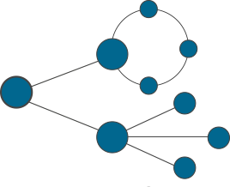



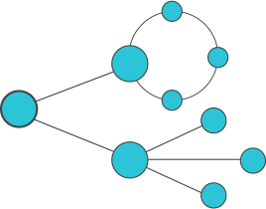


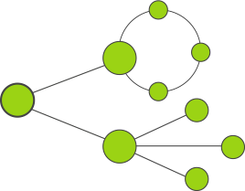


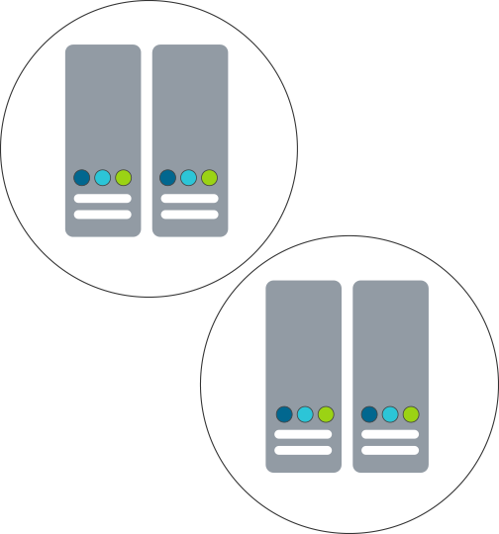






Fast Cloud Network Services
With Terabit Secure Network Data Plane
Network-as-a-Service – IPVPN, Internet Security, SASE Offerings
FD.io Fast Network Data Plane
vNF Services
Sites 1..N
IPVPN Overlays, IPsec / WireGuard / TLS Crypto
Enterprise1
vRouter vNF
SERVICE VIEW
vNF Services
Sites 1..N
IPVPN Overlays, IPsec / WireGuard / TLS Crypto
Enterprise2
vRouter vNF
vNF Services
Sites 1..N
IPVPN Overlays, IPsec / WireGuard / TLS Crypto
Enterprise3
vRouter vNF
Headquarters
Branches
Home Users
Private Clouds
Public Clouds
Secure and Fast Private Networking
Server
CPUs
Net I/O
Crypto I/O
Server
CPUs
Net I/O
Crypto I/O
Site 1
Enterprise1
Site N
PHYSICAL VIEW
IP Network
Private or Public
Cloud Hub
Site 1
Site N
Data Center1
Server
CPUs
Net I/O
Crypto I/O
Server
CPUs
Net I/O
Crypto I/O
Enterprise2
FD.io Cloud Network Service Properties:
Native cloud network data plane
Fast and Efficient
~1,000 Gbps IPsec per 2 socket Intel® Xeon® server
Site 1
Site N
Cloud Hub
Enterprise3
Data Center2

Slide 9
Fast Cloud Network Services
With Terabit Secure Network Data Plane
Software Defined Network – Cloud Network Services, IPVPN and Internet Security
FD.io Fast Network Data Plane
Network-as-a-Service – IPVPN, Internet Security, SASE Offerings
vNF Services
Sites 1..N
IPVPN Overlays, IPsec / WireGuard / TLS Crypto
Enterprise1
vRouter vNF
SERVICE VIEW
vNF Services
Sites 1..N
IPVPN Overlays, IPsec / WireGuard / TLS Crypto
Enterprise2
vRouter vNF
vNF Services
Sites 1..N
IPVPN Overlays, IPsec / WireGuard / TLS Crypto
Enterprise3
1200 GE
User Side
vRouter vNF
1200 GE
Cloud DC Side
Host-1 – Server-ICX
Host-2 – Server-ICX
600 GE
6 Ports
600 GE
6 Ports
600 GE
6 Ports
2x
100GE
100GE
x2
600 GE
6 Ports
100GE
IP Network
Private or Public
100GE
2x
2x
2x
2x
100GE
100GE
x2
2x
2x
2x
100GE
100GE
100GE
2x
x2
100GE
100GE
100GE
PHYSICAL VIEW
100GE
1-2
100GE
3-4
100GE
5-6
100GE
1-2
100GE
3-4
100GE
5-6
IPVPN Service Traffic Simulator
Traffic Generator
IPv4/v6
IPv4/v6
IPv4/v6
IPv4/v6
IPv4/v6
IPv4/v6
Sites 1..N
Sites 1..N
Sites 1..N
Services
Services
Services

Slide 10
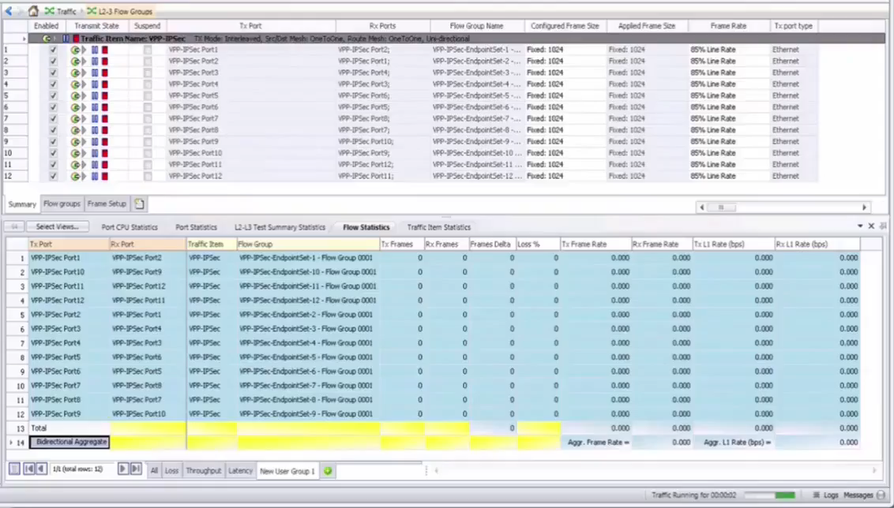
Fast Cloud Network Services - IPsec
With Terabit Secure Network Data Plane
Software Defined Network – Cloud Network Services, IPVPN and Internet Security
FD.io Fast Network Data Plane
vNF Services
Sites 1..N
IPVPN and L2VPN Overlays*, IPSec/SSL Crypto
Enterprise1
vRouter vNF
SERVICE VIEW
vNF Services
Sites 1..N
IPVPN and L2VPN Overlays*, IPSec/SSL Crypto
Enterprise2
vRouter vNF
vNF Services
Sites 1..N
IPVPN and L2VPN Overlays*, IPSec/SSL Crypto
Enterprise3
vRouter vNF
Host-1 – Server-ICX
Host-2 – Server-ICX
300 GE
4 Ports
300 GE
4 Ports
300 GE
4 Ports
600 GE
6 Ports
2x
100GE
100GE
x2
600 GE
6 Ports
IP Network
Private or Public
2x
2x
2x
100GE
100GE
2x
2x
2x
100GE
100GE
100GE
2x
x2
100GE
100GE
100GE
PHYSICAL VIEW
4 Ports = 300GE
4 Ports = 300GE
100GE
100GE
100GE
100GE
100GE
100GE
100GE
100GE
100GE
100GE
100GE
100GE
100GE
1-2
100GE
3-4
100GE
5-6
100GE
1-2
100GE
3-4
100GE
5-6
IPVPN Service Traffic Simulator
Traffic Generator
1 Terabit/s IPsec
IPv4/v6
IPv4/v6
IPv4/v6
cleartext 1024B frame size AES128GCM
IPv4/v6
IPv4/v6
IPv4/v6
Sites 1..N
Sites 1..N
Sites 1..N
Services
Services
Services

Slide 11
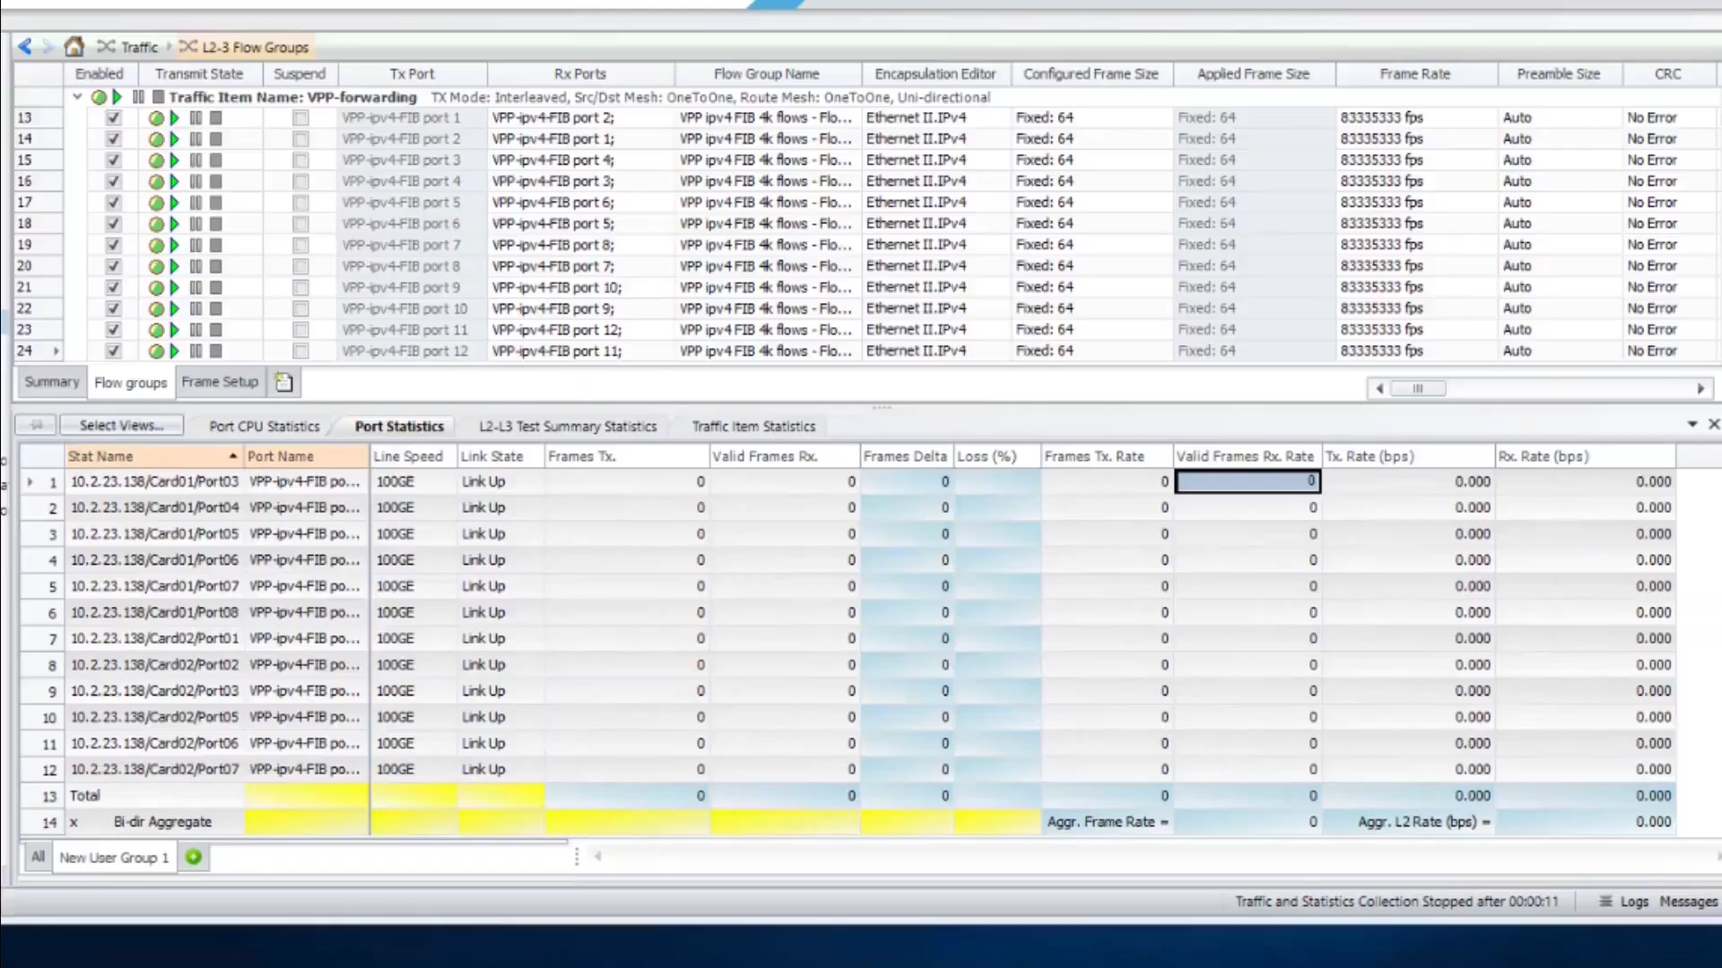
Fast Cloud Network Services – IPv4
With Terabit Secure Network Data Plane
Software Defined Network – Cloud Network Services, IPVPN and Internet Security
FD.io Fast Network Data Plane
vNF Services
Sites 1..N
IPVPN and L2VPN Overlays*, IPSec/SSL Crypto
Enterprise1
vRouter vNF
SERVICE VIEW
vNF Services
Sites 1..N
IPVPN and L2VPN Overlays*, IPSec/SSL Crypto
Enterprise2
vRouter vNF
vNF Services
Sites 1..N
IPVPN and L2VPN Overlays*, IPSec/SSL Crypto
Enterprise3
vRouter vNF
Host-1 – Server-ICX
Host-2 – Server-ICX
300 GE
4 Ports
300 GE
4 Ports
600 GE
6 Ports
2x
100GE
100GE
x2
600 GE
6 Ports
IP Network
Private or Public
2x
2x
2x
100GE
100GE
2x
2x
2x
100GE
100GE
100GE
2x
x2
100GE
100GE
100GE
PHYSICAL VIEW
100GE
100GE
100GE
100GE
100GE
100GE
100GE
100GE
100GE
100GE
100GE
100GE
100GE
1-2
100GE
3-4
100GE
5-6
100GE
1-2
100GE
3-4
100GE
5-6
IPVPN Service Traffic Simulator
Traffic Generator
1 Billion Packets/s IPv4 Routing
IPv4/v6
IPv4/v6
IPv4/v6
64B frame size 128 000 /32 Prefixes
IPv4/v6
IPv4/v6
IPv4/v6
Sites 1..N
Sites 1..N
Sites 1..N
Services
Services
Services

Slide 12
FD.io VPP – The “Magic” Behind the Equation
IPsec Encryption and Decryption
FD.io Data Plane Efficiency Metrics: { + } higher is better { - } lower is better | YESTERDAY | TODAY
 | Intel® Xeon® 6252N | Intel® Xeon® 8360Y D stp | Improvement
{ + } 2 Socket forwarding rate [Gbps] | 460 Gbps | 1000 Gbps | +117 %
{ - } Cycles / Packet | 1147 | 612 | -47 %
{ + } Instructions / Cycle | 2.89 | 2.96 | +2 %
{ - } Instructions / Packet | 3313 | 1815 | -45 %
Host-1 – Server-ICX
Host-2 – Server-ICX
IPv4 Routing
FD.io Data Plane Efficiency Metrics: { + } higher is better { - } lower is better | YESTERDAY | TODAY
 | Intel® Xeon® 6252N | Intel® Xeon® 6338N | Improvement
{ + } 2 Socket forwarding rate [Gbps] | 640 Gbps | 1200 Gbps* | +88 %
{ - } Cycles / Packet | 139 | 124 | -11 %
{ + } Instructions / Cycle | 2.90 | 3.29 | +13 %
{ - } Instructions / Packet | 405 | 409 | +1 %
600 GE
6 Ports
600 GE
6 Ports
600 GE
6 Ports
2x
100GE
100GE
x2
600 GE
6 Ports
FD.io Takes Full Advantage of Faster Intel® Xeon® Scalable Processors
100GE
IP Network
Private or Public
100GE
2x
2x
2x
2x
100GE
100GE
x2
2x
2x
2x
100GE
100GE
100GE
2x
x2
100GE
100GE
100GE
PHYSICAL VIEW
100GE
1-2
100GE
3-4
100GE
5-6
100GE
1-2
100GE
3-4
100GE
5-6
IPVPN Service Traffic Simulator
Traffic Generator
IPv4/v6
IPv4/v6
IPv4/v6
IPv4/v6
IPv4/v6
IPv4/v6
Sites 1..N
Sites 1..N
Sites 1..N
Services
Services
Services
Measured 2 Socket forwarding rate is limited by PCIe I/O slot layout on tested compute machines; nominal forwarding rate for tested FD.io VPP configuration is 600 Gbps per Processor. Not all cores are used.
Breaking the Terabit Barrier of Secure NaaS Services on a Single 2-Socket Intel® Xeon® Server !
12

Slide 13

A Terabit Secure Network Data-Plane For Native Cloud Network Services
EFFICIENCY
Most Efficient on the Planet
Now even less CPU core cycles per packet: IPsec from 1147 to 612, IPv4 from 139 to 124
PERFORMANCE
Superior Performance
Best-in-class performance metrics, Terabit rates with IPsec, Billion packets/sec with IPv4 at Scale
Flexible and Extensible
SOFTWARE NETWORKING
Many programmable NF graph nodes, ~20 extension NF plugins, maximizing flexibility
Cloud Native
CLOUD NETWORK SERVICES
User-space data plane with optimized SW / HW interface for high density cloud native micro-services
LINUX FOUNDATION
Open Source
FD.io collaboration activity: 21k+ commits, 500+ contributors, 120+ organizations
Breaking the Terabit Barrier of Secure NaaS Services on a Single 2-Socket Intel® Xeon® Server !
13

